Slide 1


REGIONAL HEALTH INTEGRATION TO ENHANCE SERVICES-N, Lango
Village Health Teams improving group antenatal care attendance and outcomes in Kole District
7th National QI Conference
2nd - 4th December 2020
Authors: Otucu Bonny, Apio Brenda, Apio Peace

Slide 2
USAID RHITES-N, Lango overview
5-year USAID funded project.
District & Community-Focused project
Supporting GOU to increase the use of sustainable health services
Supporting to 9 districts of the Lango Sub-region
John Snow, Inc. (JSI) leads the project
Sub-partners; AMREF, CUAMM, TMCG), & Another Option
Support from 12 CSOs, including Child Hug Uganda (CHU)
CHU is subgranted to implement (community-based family health activities in Kole District

Slide 3
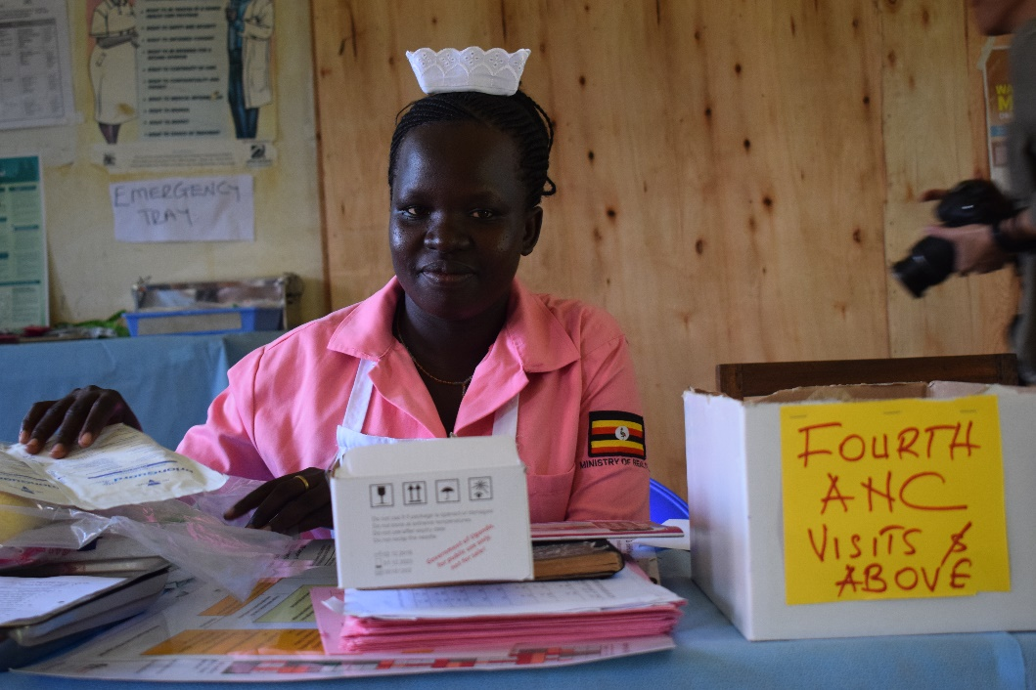
Introduction
Kole District in Lango sub-region faced a challenge of low antenatal 4 (ANC) attendance at 45%
This was due to poor follow-up of ANC dates by mothers and mobilization of mothers to go for ANC during an outreach or to the facility
CHU, funded by USAID RHITES-N, Lango project purposed to increase ANC 4 attendance from 56% in June 2020 to 75% by end of October 2020

Slide 4
Methods
    To address challenges in ANC:
    CHU held meetings with the health workers and health facilities management
    Meetings resolved to engage Village Health Teams (VHTs), to mobilize and refer pregnant mothers for ANC.
    VHTs identified and trained in ANC Services and use of tools (referral forms). 60 VHTs in total, trained and linked to health facilities
    VHTs facilitated to form Antenatal Care Groups (G-ANC) in the communities, ensuring linkage to facilities
    Each VHT formed 4 groups consisting of 10 pregnant mothers per group, five of whom were pregnant mothers in their first trimester.

Slide 5
Results
ANC coverage increased from 94% in Jan- March 2020 to 132% in April – June 2020 and 102% in July – September 2020.
A marked improvement in the number of pregnant women who attended first ANC in the First Trimester from 32% in Jan- March 2020 to 45% in April – June 2020 and 51% in July – September 2020.
Increase in ANC 4 attendance from 47% in Jan- March 2020 to 56% in April – June 2020 and 69% in July – September 2020.
252 G-ANC formed with 2,052 pregnant mothers enrolled and all have birth preparedness plans.

Slide 7
Discussion
G-ANC provided by qualified health-care professionals may be offered as an alternative to individual antenatal care
G-ANC integrates individual pregnancy health assessment with tailored group educational activities and peer support
G-ANC inspires behavioral change among pregnant women, improving pregnancy outcomes, and satisfaction
Tremendously changed the MNCH dashboard with indicators changing quarterly
The pregnant mothers are now accessing ANC services without any hustle and have birth preparedness plans

Slide 8
Lessons Learnt
VHTs bridge the gap between the community and the health facilities.
CSOs working regularly with the VHTs reach many women who can’t move to health facilities
G-ANC facilitates delivery of integrated services to expectant mothers.
The more G-ANC established; the more pregnant women reached.
The orientation of the VHTs allows early detection of complication in pregnancy.

Slide 9
Recommendations
G-ANC should be adapted as an alternative to standard ANC care to improve quality of care
G-ANC approach should be scaled up in all communities/regions to improve women’s pregnancy experiences
Since most of the pregnant mothers go for ANC but only a few of them complete the 8 visits as recommended by (MOH), G-ANC would be an avenue for the pregnant mothers to complete all their 8 visits thus strengthening referrals and documentation

Slide 10
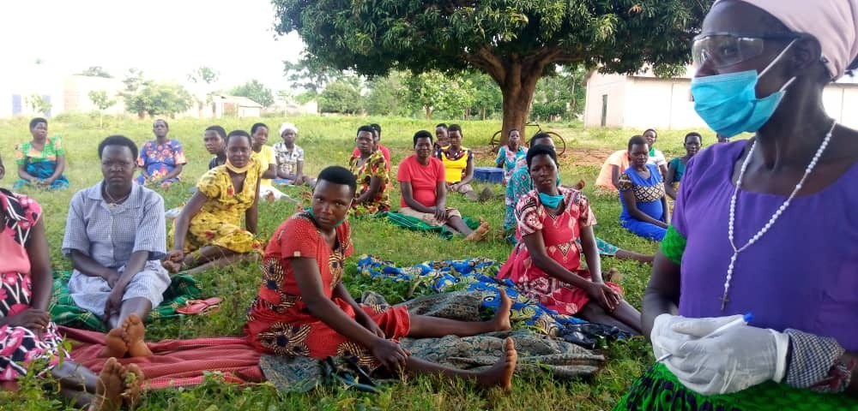
Conclusion
G-ANC approach, facilitated by VHTs, increases the number of pregnant attending ANC as evidenced in the case of Kole
Akello Florence, a VHT in Omwara, Kole District delivers a health education talk during a G-ANC session

Slide 11
Acknowledgement
John Snow Inc. (JSI) and USAID RHITES- N-Lango project
Co-authors and Management of CHU
Kole District Local Government and DHT
Ministry of Health

Slide 12
Thank you
This project is made possible by the support of the American People through the United States Agency for International Development (USAID). The contents of this presentation are the responsibility of John Snow Inc. (JSI) and do not necessarily reflect the views of USAID or the United States Government.

